Slide 1
UNIT – III UNIX PROCESS

Slide 2
Topics to be covered…
The Environment of a UNIX Process:
Introduction, main function,
Process Termination, Command-Line Arguments,
Environment List, Memory Layout of a C Program,
Shared Libraries, Memory Allocation,
Environment Variables,
setjmp and longjmp Functions,
getrlimit, setrlimit Functions,
UNIX Kernel Support for Processes.

Slide 3
UNIT 3 UNIX PROCESSES
INTRODUCTION
A Process is a program under execution in a UNIX or POSIX system.
main FUNCTION
A C program starts execution with a function called main.
The prototype for the main function is
int main(int argc, char *argv[]);
where argc is the number of command-line arguments, and argv is an array of pointers to the arguments.
When a C program is executed by the kernel by one of the exec functions, a special start-up routine is called before the main function is called.
The executable program file specifies this routine as the starting address for the program.
This is set up by the link editor when it is invoked by the C compiler.
This start-up routine takes values from the kernel, the command-line arguments and the environment and sets things up so that the main function is called.

Slide 4
UNIT 3UNIX PROCESSES
PROCESS TERMINATION
There are 5 ways for a process to terminate.
Normal termination occurs in five ways:
Return from main
Calling exit
Calling _exit or _Exit
Abnormal termination occurs in three ways:
Calling abort
Terminated by signal

Slide 5
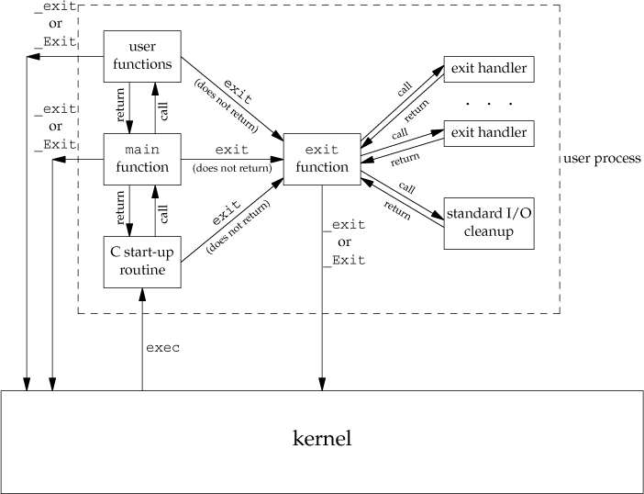
UNIT 3UNIX PROCESSES
How a C program is started and the various ways it can terminate

Slide 6
UNIT 3UNIX PROCESSES
Exit Functions
Three functions terminate a program normally:
_exit and _Exit, which return to the kernel immediately, and
exit, which performs certain cleanup processing and then returns to the kernel.
#include <stdlib.h>
void void
exit(int status);
_exit(int status);
#include <unistd.h>
void _exit(int status);
All three exit functions expect a single integer argument, called the exit status. Returning an integer value from the main function is equivalent to calling exit with the same value.
Thus exit(0) is the same as return(0) from the main function.

Slide 7
UNIT 3UNIX PROCESSES
atexit Function
With ISO C, a process can register up to 32 functions that are automatically called by exit. These are called exit handlers and are registered by calling the atexit function.
#include <stdlib.h>
int atexit(void (*func)(void));
returns: 0 if OK, nonzero on error
This declaration says that we pass the address of a function as the argument to atexit.
When this function is called, it is not passed any arguments and is not expected to return a value.
The atexit function calls these functions in reverse order of their registration.
Each function is called as many times as it was registered.

Slide 8
UNIT 3UNIX PROCESSES
Example of exit handlers
static void my_exit1(void); static void my_exit2(void); int main(void) { if (atexit(my_exit2) != 0) perror("can't register my_exit2"); if (atexit(my_exit1) != 0) perror("can't register my_exit1"); printf("main is done\n"); return(0); } | static void my_exit1(void) { printf("first exit handler\n"); } static void my_exit2(void) { printf("second exit handler\n"); } Output: $ ./a.out main is done first exit handler second exit handler

Slide 9
Abnormal Termination
Abort:
It is called when a process is in panic state.
This function terminates the process and in UNIX it causes a ‘cese’ file to be generated.
Abort( );
The cese file is useful for user to debug an aborted process.
Signals:
It’s a software interrupts for a program. This is used for abnormal termination of a process.
Kill( ) signal is used to do the same.

Slide 10
UNIT 3UNIX PROCESSES
COMMAND-LINE ARGUMENTS
When a program is executed, the process that does the exec can pass command-line arguments to the new program.
Example: Echo all command-line arguments to standard output
int main(int argc, char *argv[])
{
int i;
for (i = 0; i < argc;i++) /* echo all command-line args */ printf("argv[%d]: %s\n", i, argv[i]);
exit(0);
}
Output:
$ ./echoarg arg1 TEST foo argv[0]: ./echoarg argv[1]: arg1
argv[2]: TEST argv[3]: foo

Slide 11
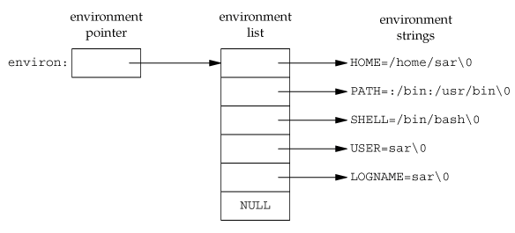
ENVIRONMENT LIST
Each program is also passed an environment list.
Like the argument list, the environment list is an array of character pointers, with each pointer containing the address of a null-terminated C string.
The address of the array of pointers is contained in the global variable environ: char * environ;
int main( int argc, char *argv[ ], char *env);
Or
int main ( int argc, char **argv, char **env);
Generally any environmental variable is of the form: name=value.
135

Slide 12
1. Program to list environment list with env variable
#include<stdio.h>
int main( int argc, char **argv, char **env)
{
int j;
for(j=0;env[j]!=NULL;j++)
{
printf(“%s\n”,env[j]);
}
}

Slide 13
2. Program to list environment list with environ variable
#include<stdio.h>
int main( int argc, char **argv, char **env)
{
int j;
extern char **environ;
for(j=0;environ[j]!=NULL;j++)
{
printf(“%s\n”,environ[j]);
}
}

Slide 14
3. Program to list environment list with getenv( ) function
#include<stdio.h>
int main()
{
char *ptr;
if((ptr = getenv(“SHELL”)) ! = NULL)
printf(“HOME = %s”, ptr);
else
printf(“HOME not defined”);
}

Slide 15
UNIT 3UNIX PROCESSES
How Memory is allocated to this program???
#include<stdio.h>
int a=5;
int b;
int data[10];
const int i=5;
int main()
{
int x;
Int *ptr = malloc(50);
return 0;
}
1
Memory block
2
Memory block
3
Memory block
4
Memory block
5
Memory block
Memory block

Slide 16
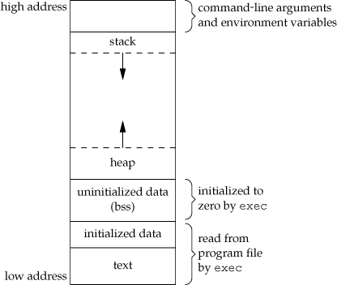
UNIT 3UNIX PROCESSES
MEMORY LAYOUT OF A C PROGRAM
#include<stdio.h>
int a=5;
int b;
int data[10];
const int i=5;
int main()
{
int x;
int *ptr = malloc(50);
return 0;
}

Slide 17
UNIT 3UNIX PROCESSES
MEMORY LAYOUT OF A C PROGRAM
Historically, a C program has been composed of the following pieces:
Text segment:
The machine instructions that the CPU executes.
Usually, the text segment is sharable so that only a single copy needs to be in memory for frequently executed programs, such as text editors, the C compiler, the shells, and so on.
Also, the text segment is often read-only, to prevent a program from accidentally
modifying its instructions.
Initialized data segment:
usually called simply the data segment, containing variables that are specifically initialized in the program.
For example, the C declaration
int maxcount = 99;
appearing outside any function causes this variable to be stored in the initialized data segment with its initial value.

Slide 18
UNIT 3UNIX PROCESSES
MEMORY LAYOUT OF A C PROGRAM
Uninitialized data segment:
Often called the "bss" segment, named after an ancient assembler operator that stood for
"block started by symbol."
Data in this segment is initialized by the kernel to arithmetic 0 or null pointers before the program starts executing.
The C declaration
long sum[1000];
appearing outside any function causes this variable to be stored in the uninitialized data
segment.

Slide 19
UNIT 3UNIX PROCESSES
MEMORY LAYOUT OF A C PROGRAM
Stack:
where automatic variables are stored, along with information that is saved each time a function is called.
Each time a function is called, the address of where to return to and certain information about the caller's environment, such as some of the machine registers, are saved on the stack.
The newly called function then allocates room on the stack for its automatic and temporary variables.
This is how recursive functions in C can work.
Each time a recursive function calls itself, a new stack frame is used, so one set of variables doesn't interfere with the variables from another instance of the function.

Slide 20
UNIT 3UNIX PROCESSES
MEMORY LAYOUT OF A C PROGRAM
Heap:
where dynamic memory allocation usually takes place.
Historically, the heap has been located between the uninitialized data and the stack.

Slide 21
UNIT 3UNIX PROCESSES
MEMORY LAYOUT OF A C PROGRAM
#include<stdio.h>
int a=5; //initialized segment (read/write)
int b; // uninitialized segment
int data[10]; // uninitialized segment
const int i=5; //initialized segment(read)
int main()
{
int x; // stack segment
int *ptr = malloc(50); //heap segment
return 0;
}

Slide 22
UNIT 3UNIX PROCESSES
MEMORY ALLOCATION
ISO C specifies three functions for memory allocation:
malloc:
which allocates a specified number of bytes of memory. The initial value of the memory is
indeterminate.
calloc:
which allocates space for a specified number of objects of a specified size. The space is initialized to all 0 bits.
realloc:
which increases or decreases the size of a previously allocated area.
When the size increases, it may involve moving the previously allocated area somewhere else, to provide the additional room at the end. Also, when the size increases, the initial value of the space between the old contents and the end of the new area is indeterminate.
140

Slide 23
UNIT 3UNIX PROCESSES
MEMORY ALLOCATION
#include <stdlib.h>
void *malloc(size_t size);
void *calloc(size_t nobj, size_t size); void *realloc(void *ptr, size_t newsize);
On success, it returns: non-null pointer , NULL on Error.
void free(void *ptr);
The function free causes the space pointed to by ptr to be deallocated.
This freed space is usually put into a pool of available memory and can be allocated in a later call to one of the three alloc functions.
.

Slide 24
UNIT 3UNIX PROCESSES
MEMORY ALLOCATION
alloca() Function
The function alloca has the same calling sequence as malloc;
however, instead of allocating memory from the heap, the memory is allocated from the stack frame of the current function.
The advantage is that we don't have to free the space;
it goes away automatically when the function returns.
The alloca function increases the size of the stack frame.
The disadvantage is that some systems can't support alloca, if it's impossible to increase the size of the stack frame after the function has been called.
.

Slide 25
UNIT 3UNIX PROCESSES
Goto and label concept
//Memory allocation sample program using malloc #include <stdio.h> #include <stdlib.h> int main() { // This pointer will hold the // base address of the block created int* ptr; int n, i; // Get the number of elements for the array n = 5; printf("Enter number of elements: %d\n", n); // Dynamically allocate memory using malloc() ptr = (int*)malloc(n * sizeof(int)); | // Check if the memory has been successfully // allocated by malloc or not if (ptr == NULL) { printf("Memory not allocated.\n"); exit(0); } else { // Memory has been successfully allocated printf("Memory successfully allocated using malloc.\n"); // Get the elements of the array for (i = 0; i < n; ++i) { ptr[i] = i + 1; } // Print the elements of the array printf("The elements of the array are: "); for (i = 0; i < n; ++i) { printf("%d, ", ptr[i]); } } return 0; }

Slide 26
UNIT 3UNIX PROCESSES
Goto and label concept
//Memory allocation sample program using calloc #include <stdio.h> #include <stdlib.h> int main() { // This pointer will hold the // base address of the block created int* ptr; int n, i; // Get the number of elements for the array n = 5; printf("Enter number of elements: %d\n", n); // Dynamically allocate memory using calloc() ptr = (int*)calloc(n, sizeof(int)); // Check if the memory has been successfully // allocated by calloc or not if (ptr == NULL) { printf("Memory not allocated.\n"); exit(0); } | else { // Memory has been successfully allocated printf("Memory successfully allocated using calloc.\n"); // Get the elements of the array for (i = 0; i < n; ++i) { ptr[i] = i + 1; } // Print the elements of the array printf("The elements of the array are: "); for (i = 0; i < n; ++i) { printf("%d, ", ptr[i]); } } return 0; }

Slide 27
UNIT 3UNIX PROCESSES
ENVIRONMENT VARIABLES
The environment strings are usually of the form: name=value.
The functions that we can use to set and fetch values from the variables are setenv, putenv, and getenv functions.
The prototype of these functions are:
#include <stdlib.h>
char *getenv(const char *name);
Returns: pointer to value associated with name, NULL if not found.
Eg:
char *res=getenv(“HOME”); cout<<“HOME=“<<res<<endl; output:
HOME=/home/syed
HOME=/home/kuldeep

Slide 28
UNIT 3UNIX PROCESSES
ENVIRONMENT VARIABLES
int putenv(char *str);
int setenv(const char *name, const char *value, int rewrite); int unsetenv(const char *name);
All return: 0 if OK, nonzero on error.
The putenv function takes a string of the form name=value and places it in the
environment list.
If name already exists, its old definition is first removed.

Slide 29
UNIT 3UNIX PROCESSES
ENVIRONMENT VARIABLES
int setenv(const char *name, const char *value, int rewrite);
All return: 0 if OK, nonzero on error.
The setenv function sets name to value.
If name already exists in the environment, then
if rewrite is nonzero, the existing definition for name is first removed;
if rewrite is 0, an existing definition for name is not removed, name is not set to the new value, and no error occurs.

Slide 30
UNIT 3UNIX PROCESSES
ENVIRONMENT VARIABLES
int unsetenv(const char *name);
All return: 0 if OK, nonzero on error.
The unsetenv function removes any definition of name. It is not an error if such a definition does not exist.
Difference between putenv() and setenv():
Whereas setenv() must allocate memory to create the name=value string from its arguments,
putenv()is free to place the string passed to it directly into the environment.

Slide 31
Example of getenv( )::
#include <stdio.h>
#include <stdlib.h>
int main ( )
{
printf("PATH : %s\n", getenv("PATH"));
printf("HOME : %s\n", getenv("HOME"));
printf("ROOT : %s\n", getenv("ROOT"));
return(0);
}
OUTPUT
PATH : /sbin:/usr/sbin:/bin:/usr/bin:/usr/local/bin HOME : /
ROOT : (null)

Slide 32
Example of putenv( )::
#include<stdio.h> #include<stdlib.h> int main() { int result=putenv("NAME=KULDEEP"); if(result==0) { printf("\n environmental variable successfully written"); printf("\n value of the environmental variable written is %s",getenv("NAME")); }
else
{ printf("\n error in writing the environmental variable"); } return 0; }
OUTPUT::
environmental variable successfully written
value of the environmental variable written is KULDEEP

Slide 33
Example of setenv( )::
#include<stdio.h>
#include<stdlib.h>
#include<unistd.h>
int main()
{
char *val = getenv("USER");
printf("\n\n Current value of environment variable USER is [%s]\n",val);
if(setenv("USER",“KULDEEP",1))
{
printf("\n setenv() failed\n");
return 1;
}
printf("\n Successfully Added a new value to existing environment variable USER\n");
val = getenv("USER");
printf("\nNew value of environment variable USER is [%s]\n",val);
return 0;
}
OUTPUT:
Current value of environment variable USER is root
Successfully Added a new value to existing environment variable USER New value of environment variable USER is KULDEEP

Slide 34
Example of unsetenv( )::
#include<stdio.h>
#include<stdlib.h>
#include<unistd.h>
int main()
{
char *val = getenv("USER");
printf("\n\n Current value of environment variable USER is [%s]\n",val);
unsetenv(“USER”);
val = getenv("USER");
printf("\nnew value of USER is [%s]\n",val);
return 0;
}
OUTPUT:
Current value of environment variable USER is root
USER New value of environment variable USER is null

Slide 35
UNIT 3UNIX PROCESSES
Goto and label concept
#include<stdio.h> main() { int i=10; printf(“Welcome”); goto jump; printf(“Hello”); printf(value of i=%d”,i); jump: printf(“I skipped you all”); } | #include<stdio.h> main() { int i=10; printf(“Welcome”); goto jump; printf(“Hello”); printf(value of i=%d”,i); } fun() { jump: printf(“I skipped you all”); }

Slide 36
goto label allows jumps only in the scope of the function
Goto label wont work across functions.
To over come this, Unix provides the functions setjmp ( ) & longjmp( )
This functions allows to jump across the functions

Slide 37
UNIT 3UNIX PROCESSES
Setjmp() & longjmp() FUNCTIONS
In C, we can't goto a label that's in another function.
Instead, we must use the setjmp and longjmp functions to perform this type of branching.
#include <setjmp.h>
int setjmp(jmp_buf env); //label
Returns: 0 if called directly, nonzero if returning from a call to longjmp
void longjmp(jmp_buf env, int val); //goto
The setjmp function records or marks a location in a program code so that later when the longjmp function is called from some other function, the execution continues from the location onwards.
The env variable(the first argument) records the necessary information needed to continue execution.
The env is of the jmp_buf defined in <setjmp.h> file, it contains the task.

Slide 38
UNIT 3UNIX PROCESSES
Setjmp() & longjmp() FUNCTIONS
The setjmp function always returns ‘0’ on its success when it is called directly in a process (for the first time).
The longjmp function is called to transfer a program flow to a location that was stored in
the env argument.
When the process is jumping to the target function, all the stack space used in the current function and its callers, upto the target function are discarded by the longjmp function.
The process resumes execution by re-executing the setjmp statement in the target function that is marked by env.
The return value of setjmp function is the value(val), as specified in the longjmp function call.
The ‘val’ should be nonzero, so that it can be used to indicate where and why the longjmp function was invoked and process can do error handling accordingly.

Slide 39
UNIT 3UNIX PROCESSES
Setjmp() & longjmp() FUNCTIONS
#include<stdio.h> #include<setjmp.h> jmp_buf buf; int main() { // Setup jump position set if (setjmp(buf)) else { printf("I am first\n"); func(); } return 0; } | void func() { printf("Welcome to the concept of setjmp & longjmp\n"); // Jump to the point setup by setjmp longjmp(buf, 1); printf("Will i get printed??"); }
printf("I am printing\n");

Slide 40
UNIT 3UNIX PROCESSES
Setjmp() & longjmp() FUNCTIONS
#include<stdio.h> #include<setjmp.h> jmp_buf buf; int main() { // Setup jump position set if (setjmp(buf)) else { printf("I am first\n"); func(); } return 0; } | void func() { printf("Welcome to the concept of setjmp & longjmp\n"); // Jump to the point setup by setjmp longjmp(buf, 1); printf("Will i get printed??"); }
printf("I am printing\n");

Slide 41
UNIT 3UNIX PROCESSES
Setjmp() & longjmp() FUNCTIONS
#include<stdio.h> #include<setjmp.h> jmp_buf buf; int main() { // Setup jump position set if (setjmp(buf)) else { printf("I am first\n"); func(); } return 0; } | void func() { printf("Welcome to the concept of setjmp & longjmp\n"); // Jump to the point setup by setjmp longjmp(buf, 1); printf("Will i get printed??"); }
printf("I am printing\n");

Slide 42
UNIT 3UNIX PROCESSES
Setjmp() & longjmp() FUNCTIONS
#include<stdio.h> #include<setjmp.h> jmp_buf buf; int main() { // Setup jump position set if (setjmp(buf)) else { printf("I am first\n"); func(); } return 0; } | void func() { printf("Welcome to the concept of setjmp & longjmp\n"); // Jump to the point setup by setjmp longjmp(buf, 1); printf("Will i get printed??"); }
printf("I am printing\n");

Slide 43
UNIT 3UNIX PROCESSES
Setjmp() & longjmp() FUNCTIONS
#include<stdio.h> #include<setjmp.h> jmp_buf buf; int main() { // Setup jump position set if (setjmp(buf)) else { printf("I am first\n"); func(); } return 0; } | void func() { printf("Welcome to the concept of setjmp & longjmp\n"); // Jump to the point setup by setjmp longjmp(buf, 1); printf("Will i get printed??"); }
printf("I am printing\n");

Slide 44
UNIT 3UNIX PROCESSES
Setjmp() & longjmp() FUNCTIONS
#include<stdio.h> #include<setjmp.h> jmp_buf buf; int main() { // Setup jump position set if (setjmp(buf)) else { printf("I am first\n"); func(); } return 0; } | void func() { printf("Welcome to the concept of setjmp & longjmp\n"); // Jump to the point setup by setjmp longjmp(buf, 1); printf("Will i get printed??"); }
3
1
printf("I am printing\n");
4
2

Slide 45
UNIT 3UNIX PROCESSES
getrlimit() AND setrlimit() FUNCTIONS
Every process has a set of resource limits, some of which can be queried and changed
by the getrlimit and setrlimit functions.
#include <sys/resource.h>
int getrlimit(int resource, struct rlimit *rlptr);
int setrlimit(int resource, const struct rlimit *rlptr);
Both return: 0 if OK, nonzero on error
Each call to these two functions specifies a single resource and a pointer to the following structure:
struct rlimit
{
rlim_t rlim_cur; /* soft limit: current limit */
rlim_t rlim_max; /* hard limit: maximum value for rlim_cur */
};
150

Slide 46
UNIT 3UNIX PROCESSES
getrlimit() AND setrlimit() FUNCTIONS
Three rules govern the changing of the resource limits.
A process can change its soft limit to a value less than or equal to its hard limit.
A process can lower its hard limit to a value greater than or equal to its soft limit. This lowering of the hard limit is irreversible for normal users.
Only a super user process can raise a hard limit.
An infinite limit is specified by the constant RLIM_INFINITY.
 | RLIMIT_AS | The maximum size in bytes of a process's total available memory.
 | RLIMIT_CORE | The maximum size in bytes of a core file. A limit of 0 prevents the creation of a core file.
 | RLIMIT_CPU | The maximum amount of CPU time in seconds. When the soft limit is exceeded, the SIGXCPU signal is sent to the process.
 | RLIMIT_DATA | The maximum size in bytes of the data segment: the sum of the initialized data, uninitialized data, and heap.
 | RLIMIT_FSIZE | The maximum size in bytes of a file that may be created. When the soft limit is exceeded, the process is sent the SIGXFSZ signal.
 | RLIMIT_LOCKS | The maximum number of file locks a process can hold.
 | RLIMIT_NOFILE | The maximum number of open files per process. Changing this limit affects the value returned by the sysconffunction for its _SC_OPEN_MAXargument
 | RLIMIT_NPROC | The maximum number of child processes per real user ID. Changing this limit affects the value returned for _SC_CHIL^{PR}D^{OF}_^{. S}M^{YED}A^{MU}X^{STA}b^{FA}y^{, H}t^{K}h^{BK}e^{CE} sysconffunction ¹⁵¹

Slide 47
UNIT 3UNIX PROCESSES
// C program to demonstrate working of getrlimit() // and setlimit() #include <stdio.h> #include <sys/resource.h> #include <string.h> //#include <errno.h> #include <unistd.h> #include <sys/types.h> #include <sys/stat.h> #include <fcntl.h> int main() { struct rlimit old_lim, lim, new_lim; // Get old limits if( getrlimit(RLIMIT_NOFILE, &old_lim) == 0) printf("Old limits -> soft limit= %ld \t" " hard limit= %ld \n", old_lim.rlim_cur, old_lim.rlim_max); | // Set new value lim.rlim_cur = 3; lim.rlim_max = 1024; // Set limits (setrlimit(RLIMIT_NOFILE, &lim) // Get new limits if( getrlimit(RLIMIT_NOFILE, &new_lim) == 0) printf("New limits -> soft limit= %ld " "\t hard limit= %ld \n", new_lim.rlim_cur, new_lim.rlim_max); else fprintf(stderr, "%s\n", strerror(errno)); return 0; }
getrlimit() AND setrlimit() FUNCTIONS
Example: Print the current resource limits

Slide 48
UNIT 3UNIX PROCESSES
OUTPUT::
Old limits :: soft limit= 1024 hard limit= 124
New limits :: soft limit= 3 hard limit= 100

Slide 49
UNIT 3UNIX PROCESSES
UNIX KERNEL SUPPORT FOR PROCESS
UNIX kernel has a process table that keeps track of all active process present in the system. Some of these processes belongs to the kernel and are called as “system process”.
Every entry in the process table contains pointers to the text, data and the stack segments and also to U-area of a process.
U-area of a process is an extension of the process table entry and contains other process specific data such as the file descriptor table, current root and working directory inode numbers and set of system imposed process limits.
All processes in UNIX system expect the process that is created by the system boot code, are created by the fork system call.

Slide 50
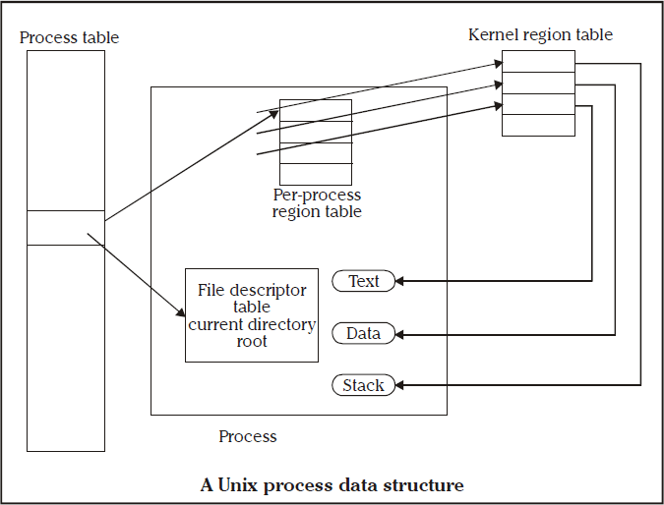
UNIT 3UNIX PROCESSES
UNIX KERNEL SUPPORT FOR PROCESS
Pre process U area

Slide 51
A process consists of
A text segment – program text of a process in machine executable instruction code format
A data segment – static and global variables in machine executable format
A stack segment – function arguments, automatic variables and return addresses of all active functions of a process at any time
U-area is an extension of Process table entry and contains process-specific data

Slide 52
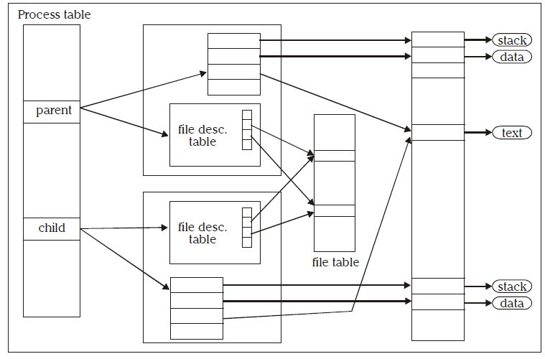
UNIT 3UNIX PROCESSES
UNIX KERNEL SUPPORT FOR PROCESS
After the fork system call, once the child process is created, both the parent and child processes resumes execution.
When a process is created by fork, it contains duplicated copies of the text, data and stack segments of its parent as shown in the Figure below.
Also it has a file descriptor table, which contains reference to the same opened files as the parent, such that they both share the same file pointer to each opened files.

Slide 53
UNIT 3UNIX PROCESSES
UNIX KERNEL SUPPORT FOR PROCESS
The process will be assigned with attributes, which are either inherited from its parent or will be set by the kernel.
Attributes | Meaning
Current directory | this is the reference (inode number) to a working directory file
Root directory | this is the reference to a root directory
Signal handling | the signal handling settings
Signal mask | a signal mask that specifies which signals are to be blocked
Umask | a file mode mask that is used in creation of files to specify which accession rights should be taken out.
Nice value | the process scheduling priority value
Controlling terminal | the controlling terminal of the process

Slide 54
UNIT 3UNIX PROCESSES
UNIX KERNEL SUPPORT FOR PROCESS
In addition to the above attributes, the following attributes are different between the parent and child processes:
Attributes | Meaning
Process identification number (PID) | an integer identification number that is unique per process in an entire operating system.
Parent process identification number (PPID) | the parent process PID
Pending signals | the set of signals that are pending delivery to the parent process
Alarm clock time | the process alarm clock time is reset to zero in the child process
File locks | the set of file locks owned by the parent process is not inherited by the chid process

Slide 55
Revision::
Main Function---
Command line arguments---
Process termination---
Environment list
Environment variables
Memory layout of C program
Memory allocation
Setjmp & longjmp
Sertrlimit & getrlimit
Unix kernel support for process…..

Slide 56
END

